Slide 1
· Religious and cultural traditions were transformed as they spread
Prove this to me in a paragraph

Slide 2
Land and water routes became the basis for transregional trade, communication, and exchange networks in the Eastern Hemisphere. New technologies facilitated long-distance communication and exchange. Alongside the trade in goods, the exchange of people, technology, religious and cultural beliefs, food crops, domesticated animals, and disease pathogens developed across far-flung networks of communication and exchange.
Many factors including climate & location of routes, the typical goods, and the ethnicity of people involved, shaped the distinctive features of the Trans-Sahara caravan routes.
New technologies permitted the use of domestic pack animals to transport goods across longer routes

Slide 3
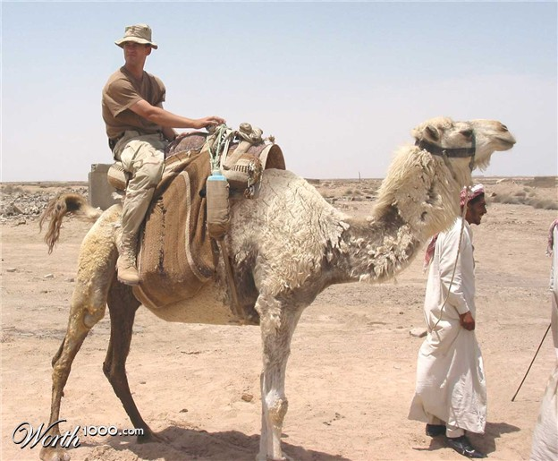
Notes:
South Arabian Camel Saddle – riding and cargo (about 500 lbs) but bad for military, Camels were used in packs during at 1500 BC. They were used in the overland incense trade and for riding. This is also the time that the South Arabic Saddle was invented (Clutton-Brock 148). The South Arabian saddle was modified for peaceful purposes and comfortable riding. The saddle was separated so that one arch was in the front and the other in the back of the saddle so that the camel's hump would not be abraded and it would not hurt the camel (Clutton-Brock 96).

Slide 4
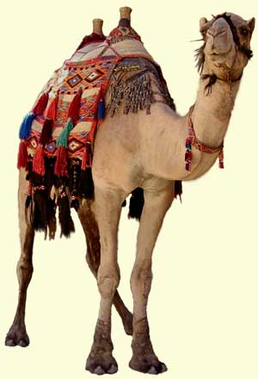
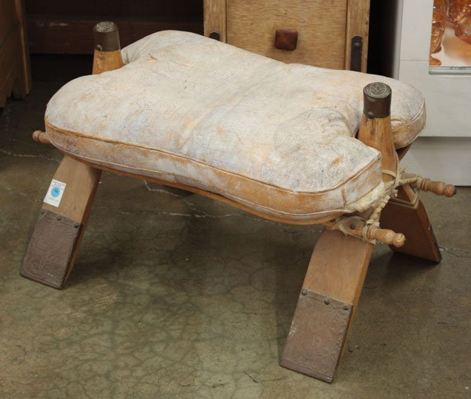
Notes:
North Arabian Camel Saddle, c. 100 BCE – cargo, gave rider height advantage in battle and a solid seat
The North Arabic saddle was used for more military purposes. It was made of rectangular goat hair, filled with sheeps wool, and had a minimal use of stone. The saddle has two arches shaped like inverted V's that are part of the pad on the front of the saddle and a pad on the back. The arches are connected by sticks to form a frame that is above the hump where the rider sits. This divides the rider's weight so that he is not placing all of his weight on the hump, but around the camel's rib cage (Bulliet 87)
Camels in war: Camels were used especially by the Arabs and Assyrians during war. They were very valuable and were not only used during battle instead of horses, but also as booty for the victors in battle. It is known that warriors were mounted on camels due to different types of artistic documentation during the seventh century. Assyrians especially used camels during war to bring in supplies such as water. Through battle, the Assyrians introduced camels to the Persians who in turn used camels instead of horses to inspire fear in their enemies (Cohler-Rollefson184).

Slide 5
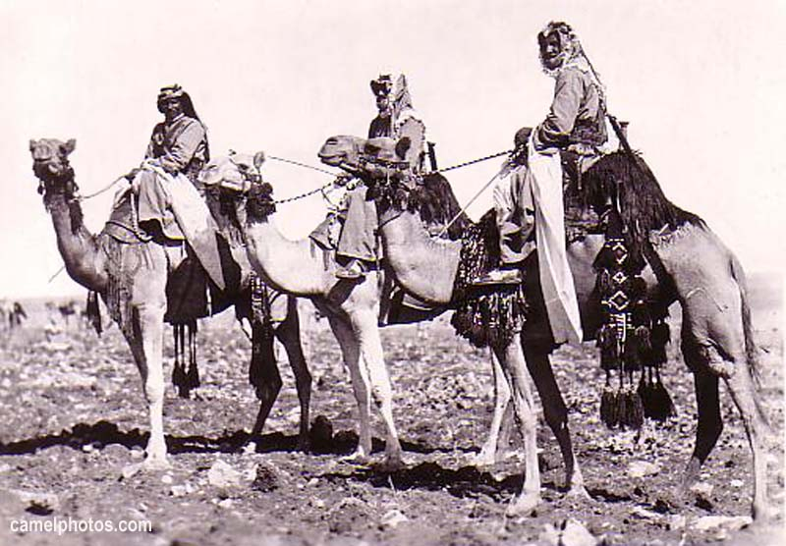
Notes:
Rider uses a stick to control camel

Slide 6
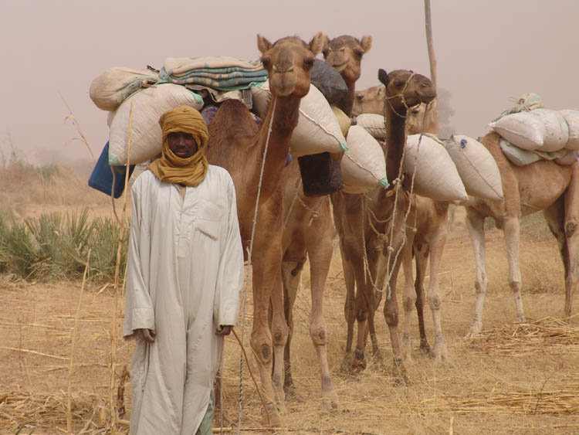
Notes:
Camel arrives in Africa c. 46 BCE – Egypt across central Sahara then northward

Slide 7
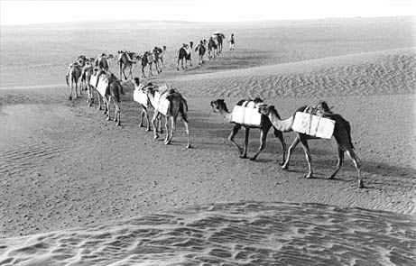
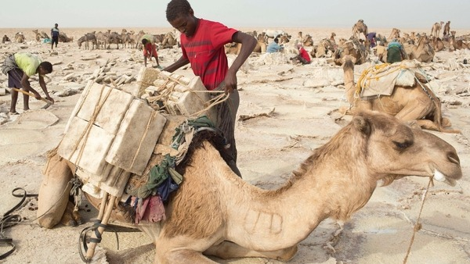
Salt Mines
Notes:
Gold Trade and the Kingdom of Ancient Ghana Around c. 400 CE, thanks to the availability of the camel, Berber-speaking people began crossing the Sahara Desert. From the eighth century onward, annual trade caravans followed routes later described by Arabic authors with minute attention to detail. Gold, sought from the western and central Sudan, was the main commodity of the trans-Saharan trade. The traffic in gold was spurred by the demand for and supply of coinage. The rise of the Soninke empire of Ghana appears to be related to the beginnings of the trans-Saharan gold trade in the fifth century.

Slide 8
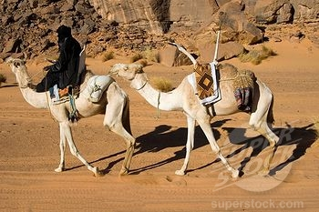
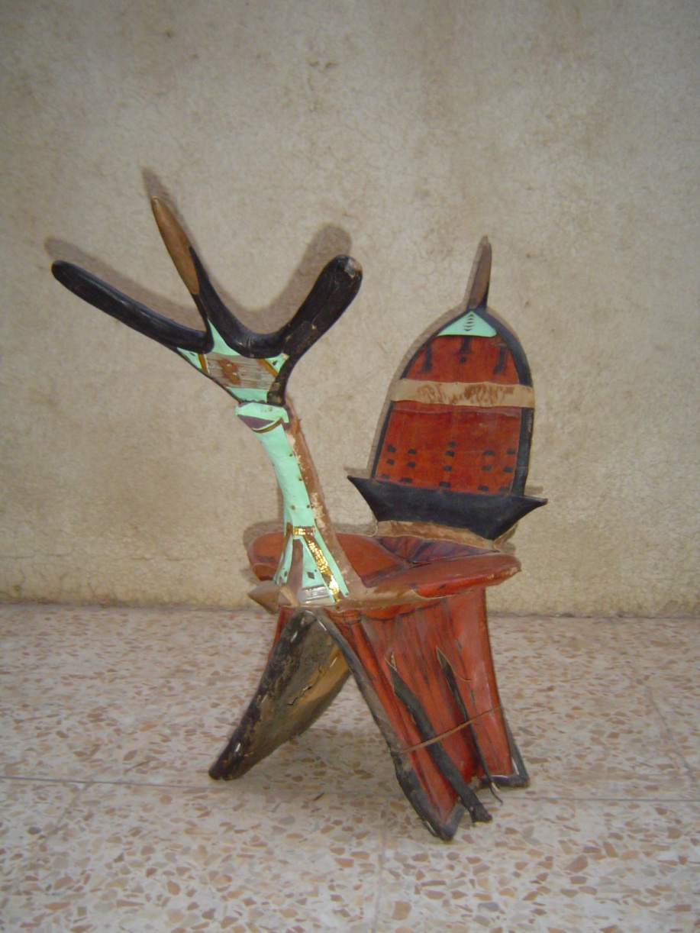
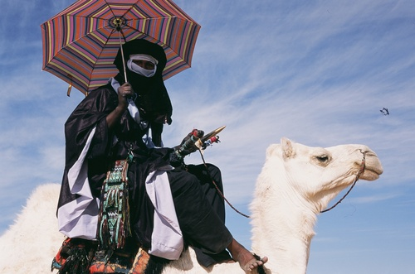
Notes:
Tuareg Saddle, rider sits over withers and controls animal with toes – free to hold sword

Slide 9
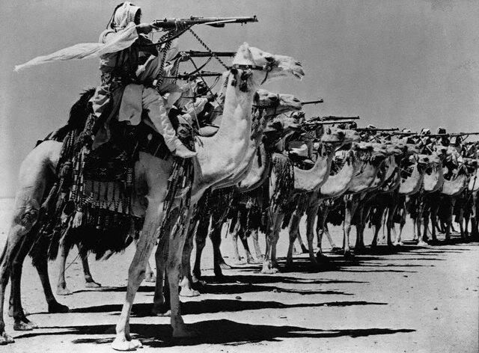

Slide 10
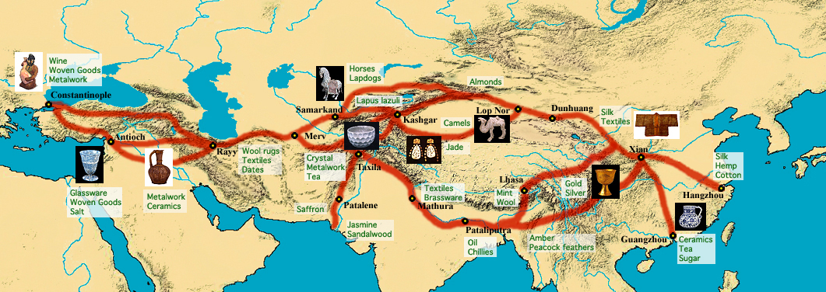
On the Silk Road

Slide 11
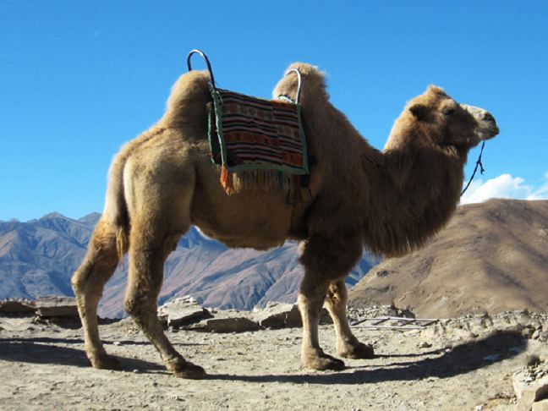
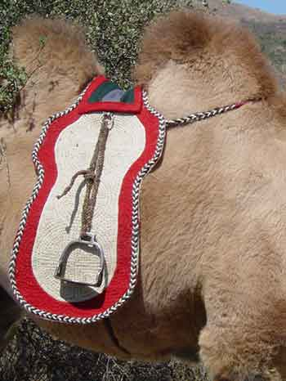
Notes:
Bactrian Camels: carry loads of 400 lbs, 30-40 kms daily, 20-25 years of productive work, They are at their best in the dry cold of the winter -Able to withstand extremes of heat and cold, Consistent heat, however, is intolerable for Bactrians.

Slide 12
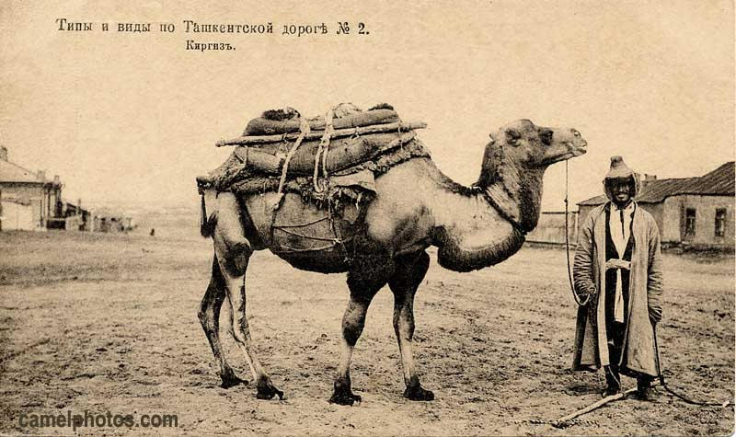

Slide 13
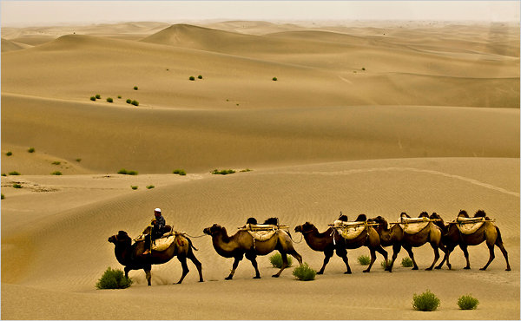
Notes:
Silk Road Caravan

Slide 14
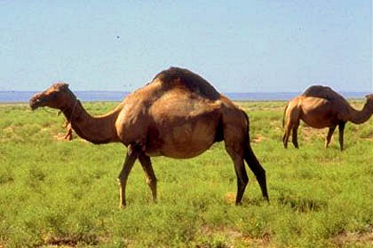
Notes:
Hybrid Camel: can carry 1,000 lbs, double that of parents – Male Bactrian crossed with Dromadary – likely practiced through the classical period “in my experience, the main advantage of the hybrid over the purer species, to both nomadic and commercial users, is less its supposed versatility than its vastly greater size, strength and carrying capacity, its aesthetically pleasing appearance, and its correspondingly greater value, in both financial and ceremonial terms.”

