Slide 1
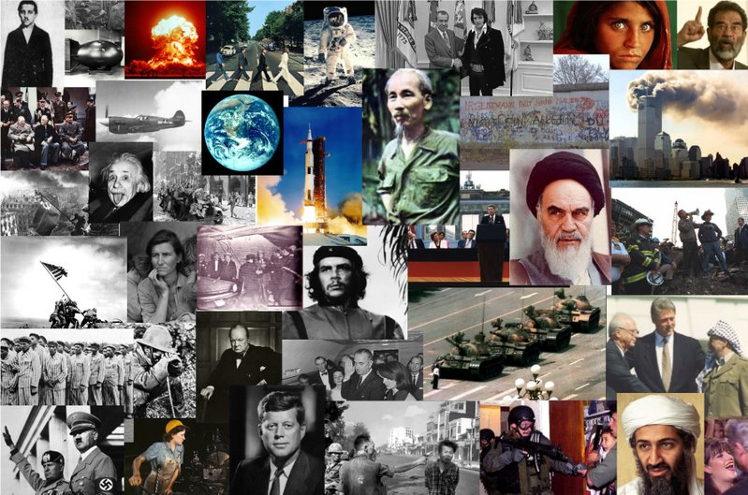
1900 to present
The Post-modern era in brief

Slide 2
This period is all about…
Legacy of Imperialism
Communism vs. Capitalism
Global Conflict
Global inter-connectedness
Changing Reality

Slide 3
1900’s
Boxer rebellion suppressed in China, 1900
Russia loses Russo-Japanese War
First Revolution in Russia, 1905
Panama gain’s independence from Colombia with US support , construction of Panama Canal Begins
Ford introduced Model T, 1908
Young Turks come to power in Ottoman Empire, 1908
Einstein & Freud publish, 1905

Slide 4
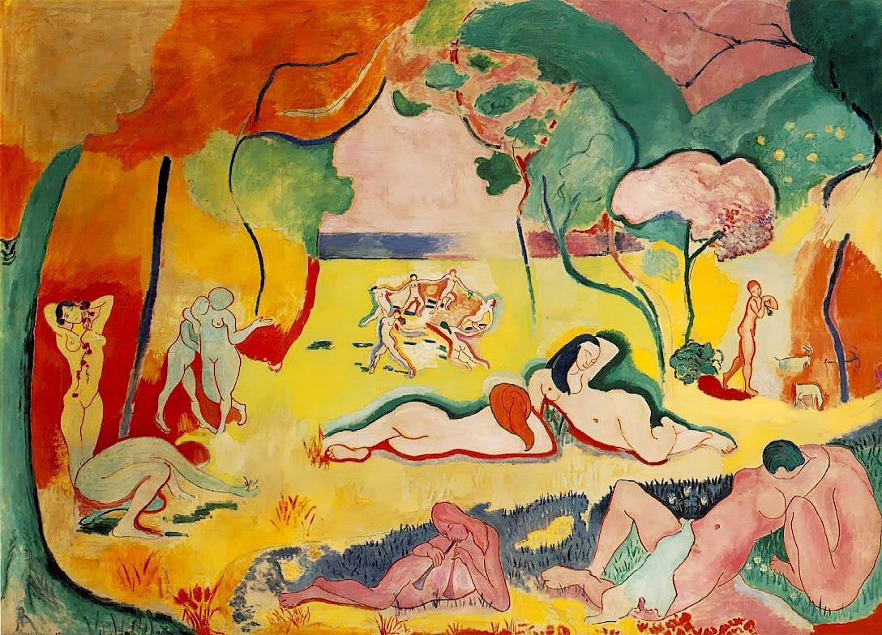
Notes:
The Joy of Life, Matisse – Fauves -- The Joy of Life investigates the significance of the idyllic in French painting from the early 1890s to World War I, considering a fascinating series of pastoral, mythic, and utopian landscapes. Responding to rapid artistic and social shifts in this period, French artists shaped a dreamlike imagery of mythic community, individual fantasy, and sensual joie de vivre in the midst of mass society.

Slide 5
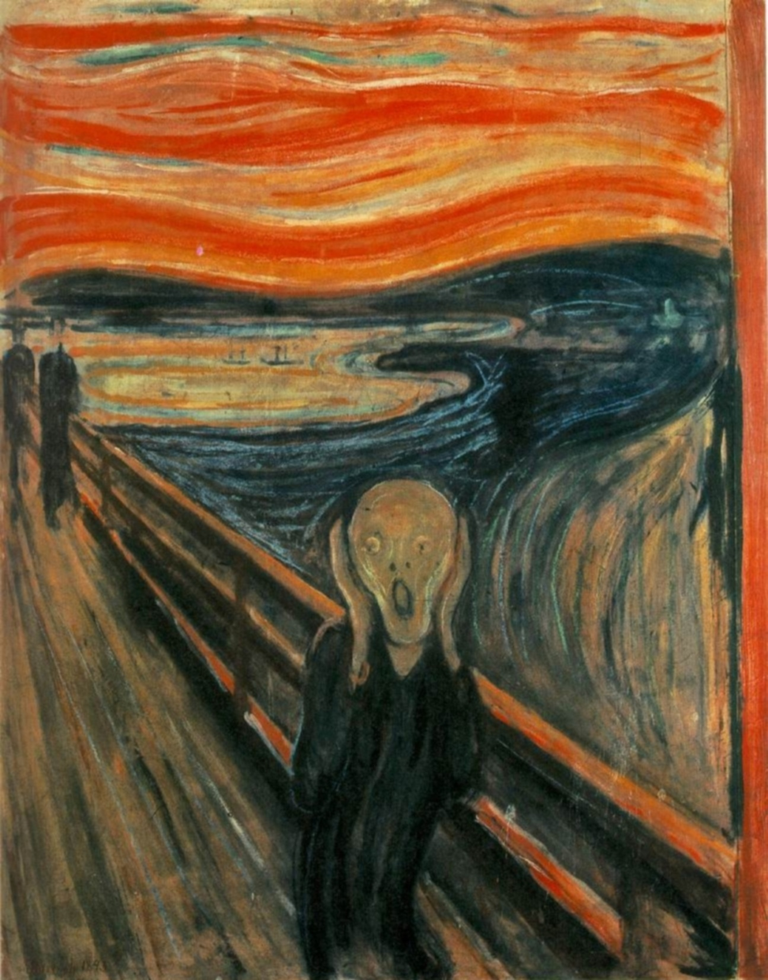
Notes:
The Scream, 1893 Munch, Expressionism

Slide 6
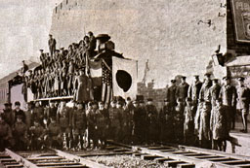
Boxer rebellion suppressed in China, 1900
Legacy of Imperialism

Slide 7
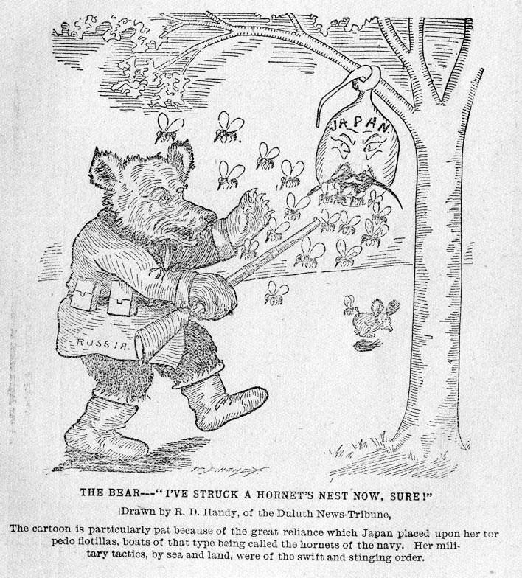
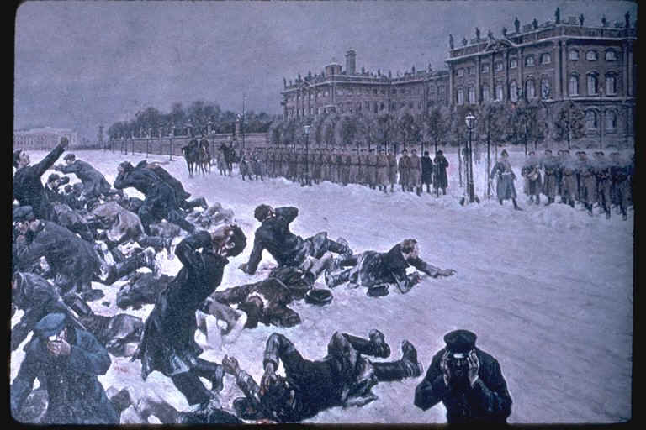
Russia loses Russo-Japanese War
First Revolution in Russia, 1905
Communism vs. Capitalism

Slide 8
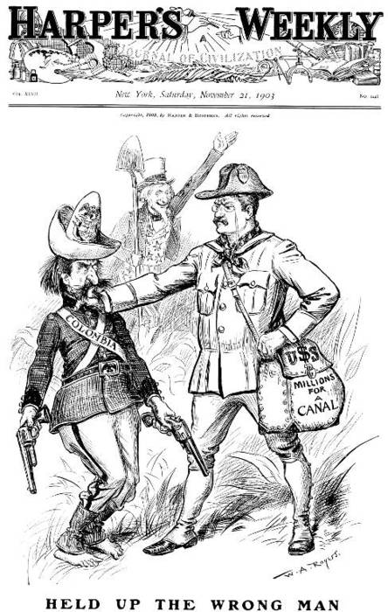
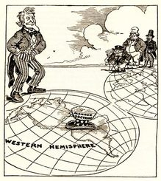
Panama gain’s independence from Colombia with US support , construction of Panama Canal Begins
Legacy of Imperialism

Slide 9
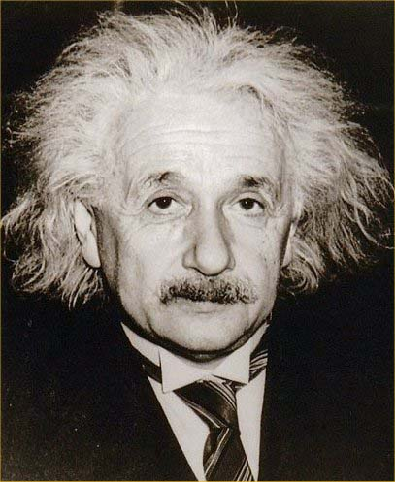
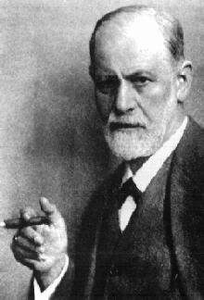
Einstein & Freud publish, 1905
Changing Reality

Slide 10
1910’s
World War I, 1914-1919
Russian Revolution
Panama Canal Complete, 1914
Mexican Revolution, 1910-1920
Union of South Africa formed, 1910
African National Congress created 1912
Fall of Qing Dynasty founding of Chinese Republic, 1911
Balfour Declaration – first step in creation of Israel, 1917
Gandhi returns to India, 1915
Spanish Flu Pandemic, 1918

Slide 11
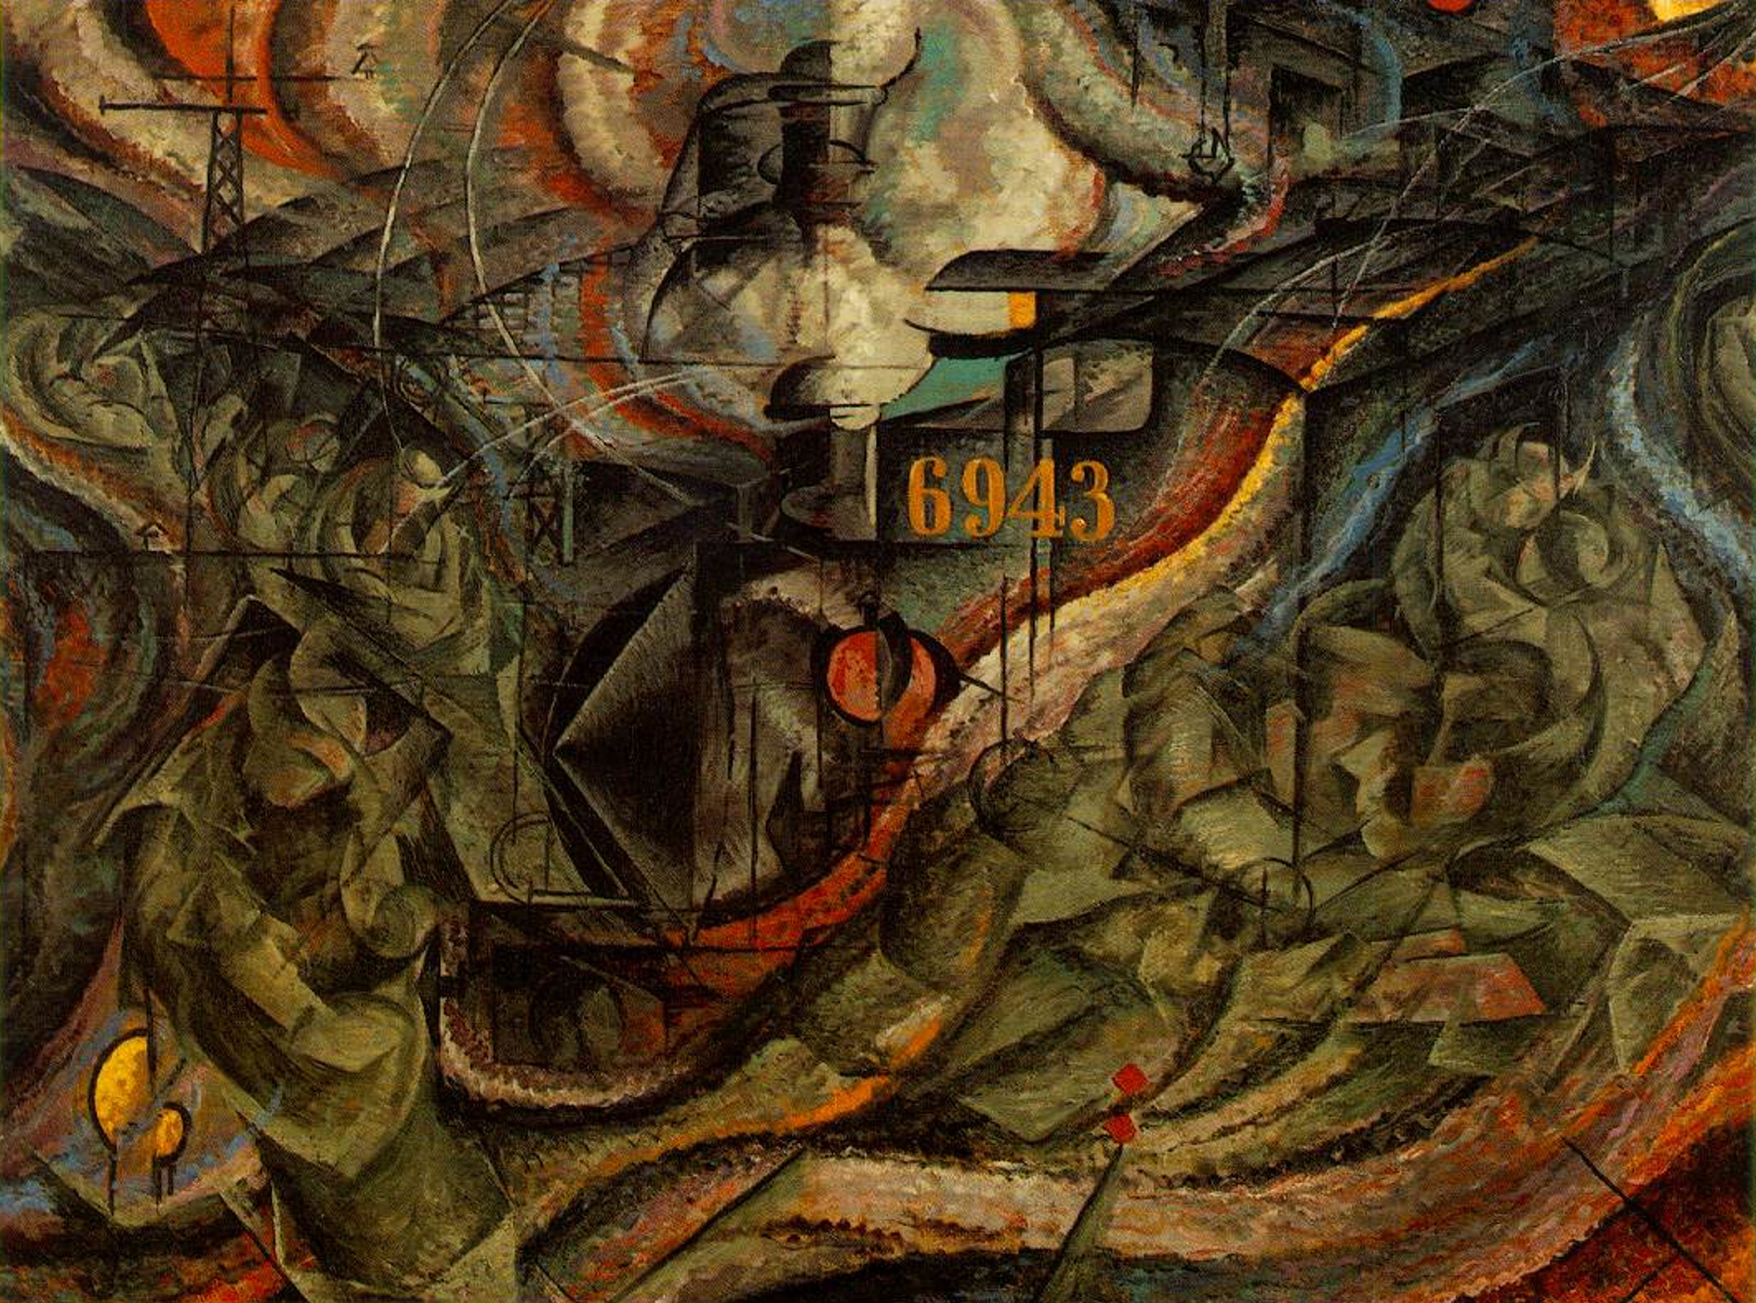
Notes:
Boccioni, Umberto | States of Mind: The Farewells.

Slide 12
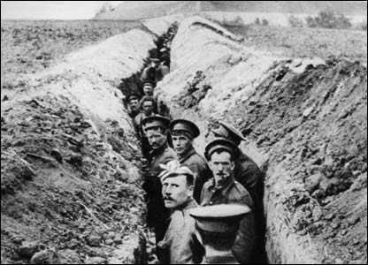
World War I, 1914-1919
Spanish Flu Pandemic, 1918
Global Conflict
M.
A.
I.
N.

Slide 13
Industrialization created a demand for…
Raw Materials
The demand for raw materials led to…
Imperialism
Imperialism led to competition and an increase in…
Nationalism
Nationalism intensified competition and led to…
Militarism
Massive military build up caused instability and led to the…
Alliance System

Slide 14
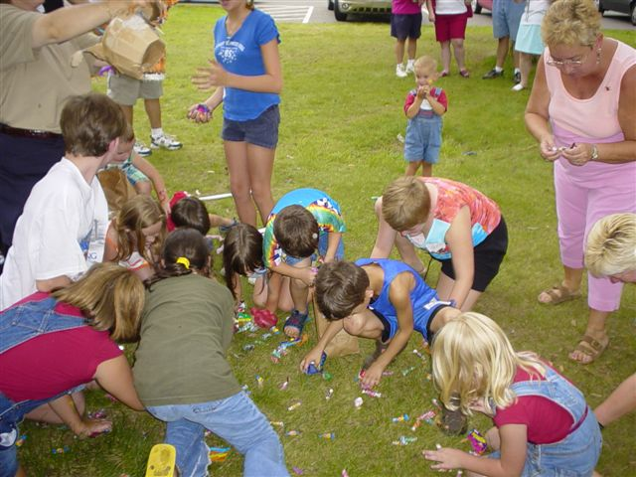

Slide 15
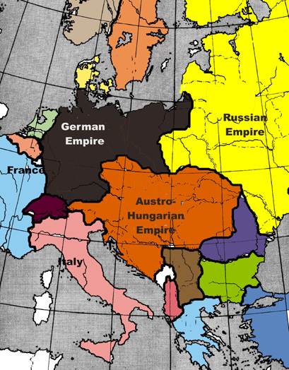
Poles want independence
Europe before
World War I
The Rise of
Ethnic
Nationalism
Czechs want independence
Slavs in the Balkans want unity and independence

Slide 16
Former Ottoman Empire
Decline of the Ottoman Empire
Serbia wanted to unite Slavs into one country
Slavic Nationality divided into several countries

Slide 17
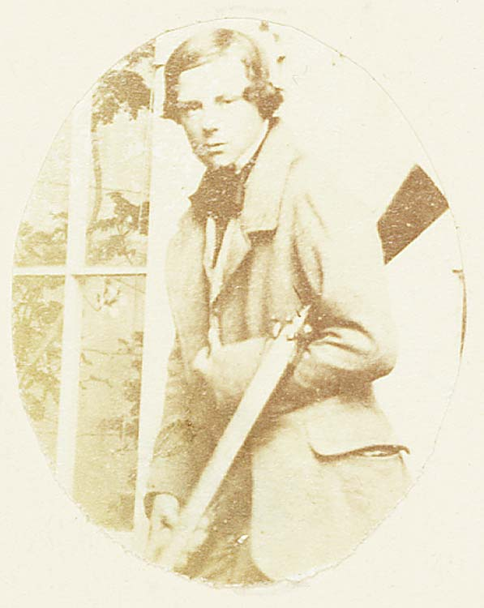
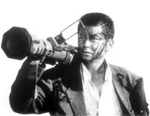
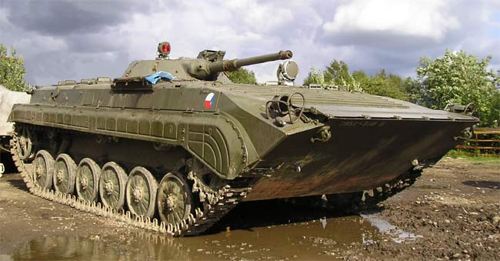

Slide 18
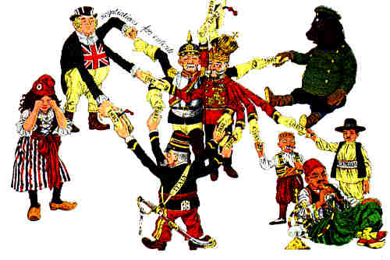

Slide 19
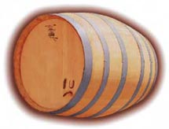
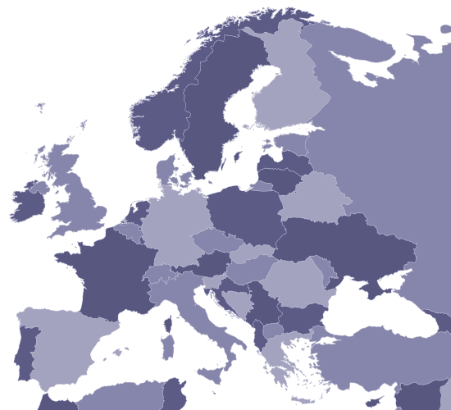
Economic Rivalry
Gun powder
Nationalism
Ethnic Nationalism
Competition for colonies
⬅ A l l i a n c e ➔
⬅ A l l i a n c e ➔
⬅ A l l i a n c e ➔
⬅ A l l i a n c e ➔

Slide 20
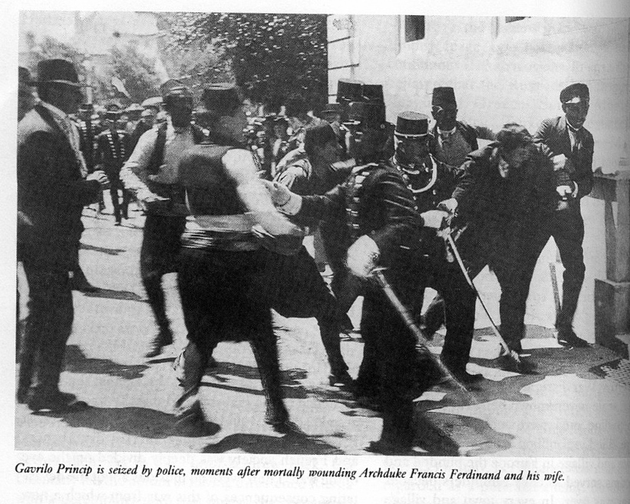
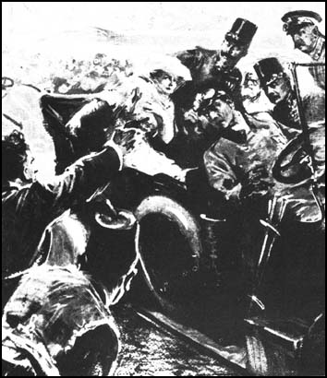
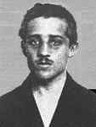
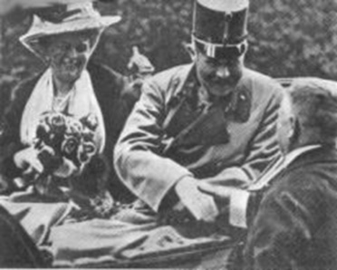
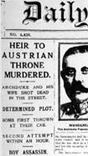

Slide 21
Economic Rivalry
Gun powder
Nationalism
Ethnic Nationalism
Competition for colonies
⬅ A l l i a n c e ➔
World War I
⬅ A l l i a n c e ➔
⬅ A l l i a n c e ➔
⬅ A l l i a n c e ➔

Slide 22
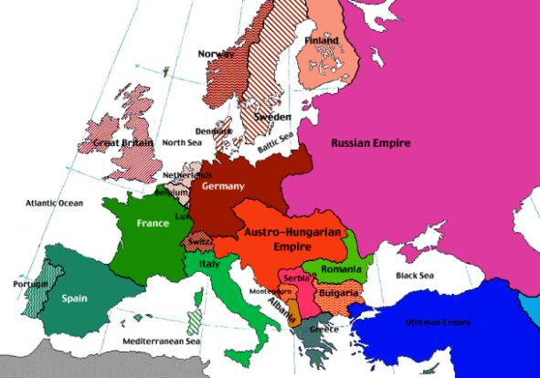
A
A
A
C
A
C
A
C
A
C

Slide 23
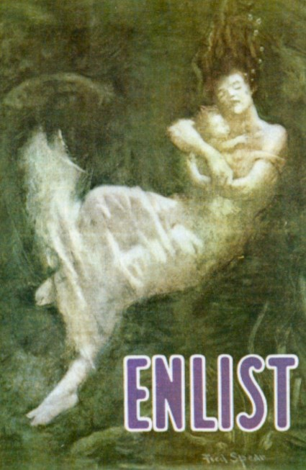

Slide 24
Clip
http://www.youtube.com/watch?v=Ciq9ts02ci4

Slide 25
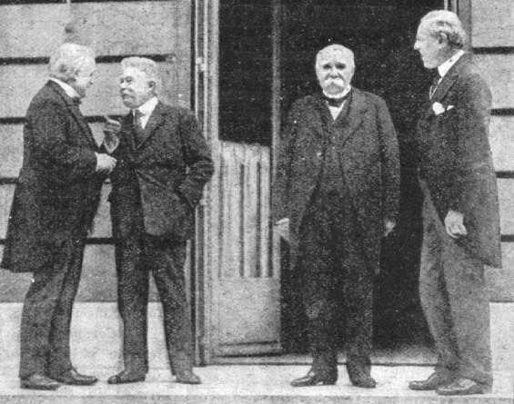

Slide 26
The 14 Points
Open diplomacy
Freedom of the Seas
Removal of Trade Barriers
Arms Reduction
Impartial adjustment of colonial claims with consideration to the native population
Redraw the borders in the world so nationalities could have their own country
League of Nations

Slide 27
Outcome
14 points mostly thrown out window
New countries created: Poland, Czechoslovakia, Yugoslavia…
France & Britain took Middle East from Ottoman Empire
Italy got some of Austria
France got Alsace & Lorraine back
Germany Demilitarized

Slide 28
Germany had to pay $33 billion in reparations
Germany had to sign the War-guilt Clause
Germany lost her colonies
League of Nations formed – collective security
US never joined

Slide 29
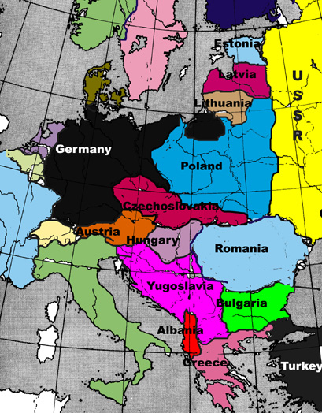
Before the War
After the War

Slide 30
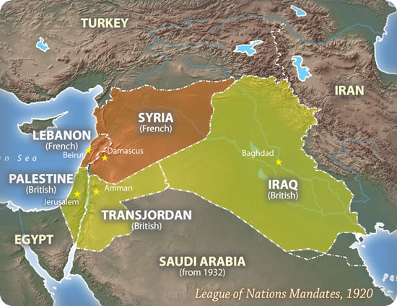

Slide 31
http://www.youtube.com/watch?v=rbYwNOcKqqc

Slide 32
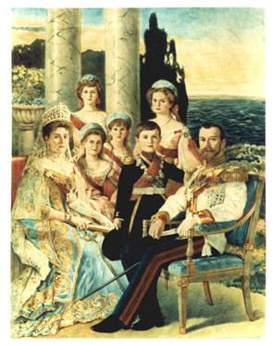
Russian Revolution
Communism vs. Capitalism

Slide 33
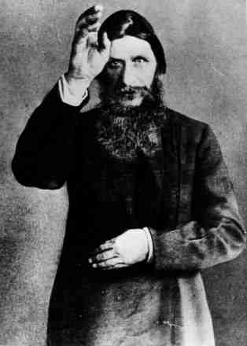
Rasputin

Slide 35
Bloody Sunday

Slide 36
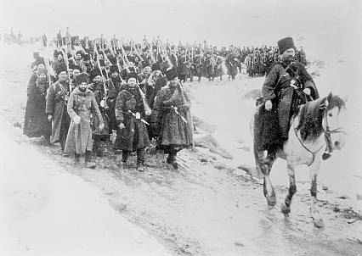
Eastern Front in World War I

Slide 37
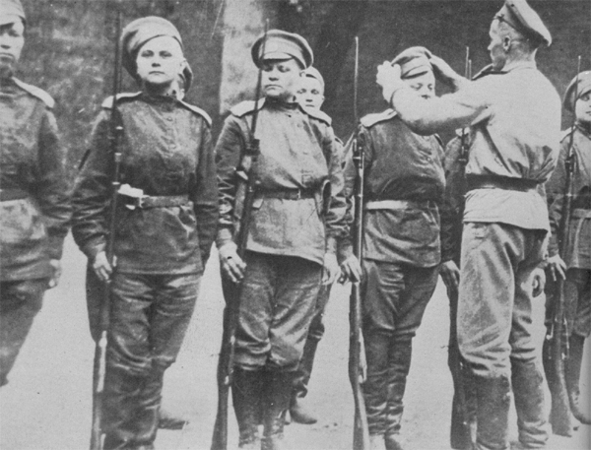
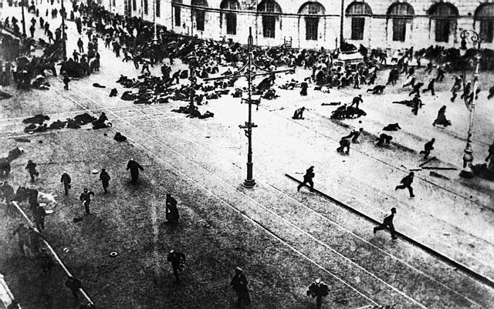
Back at Home
Down with the Czar
Peace &
Bread!
Peace!
Peace!
Bread!
Peace!
Bread!
Nicholas called in the army to put down the riot
Bread!
Army joined protest
Petrograd Riots

Slide 38
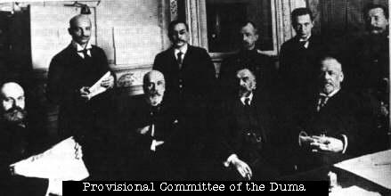
-After Czar abdicated the government was controlled by the Duma (like a congress) made up of men from the Middle Class

Slide 39
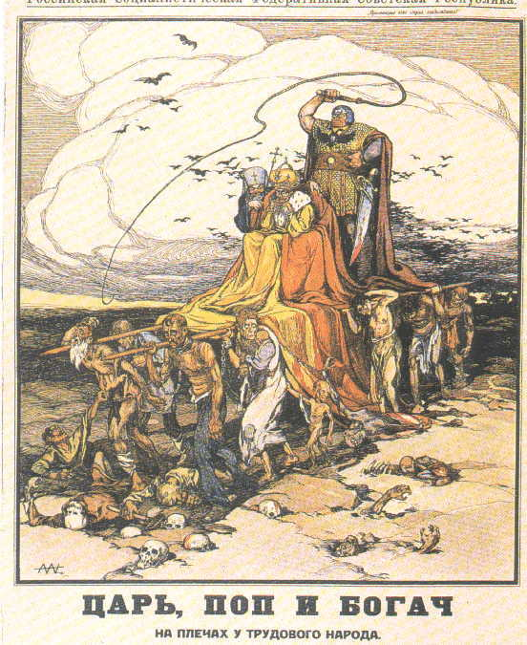
Mensheviks
Bolsheviks

Slide 40
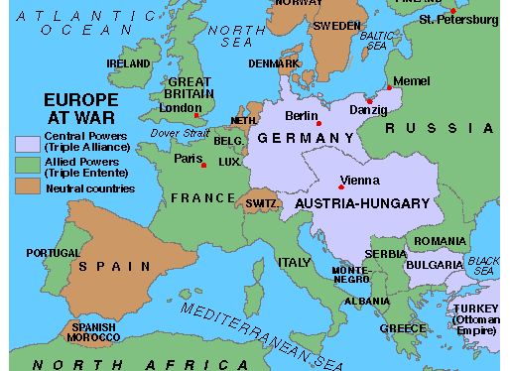
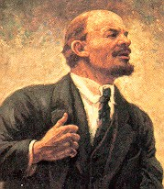
Lenin

Slide 41
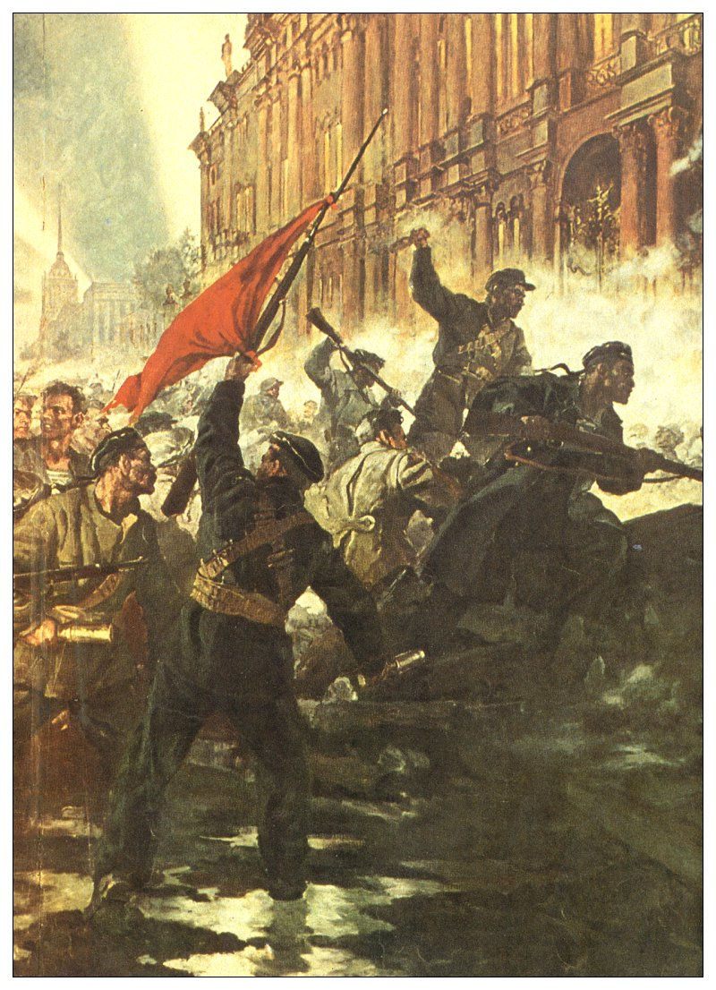
Peace, Land & Bread!
All power to the Soviet!
October
Revolution
-Bolsheviks took power in a coup d’ etat

Slide 42
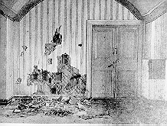
Bolsheviks killed the Czar and his entire family

Slide 43
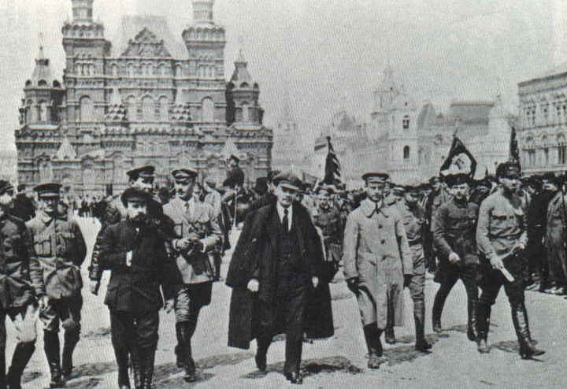
Lenin became leader as the head of the communist party

Slide 44
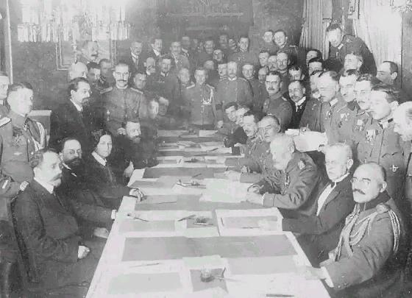
Treaty of Brest-Litovsk
Russia withdrew from WW I

Slide 45
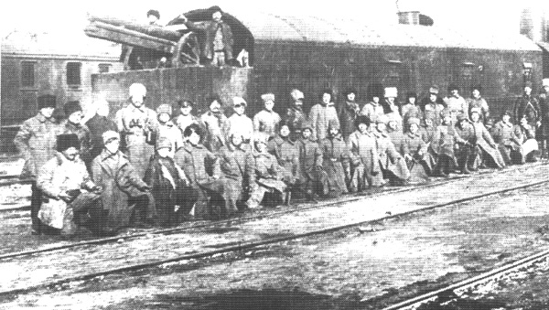
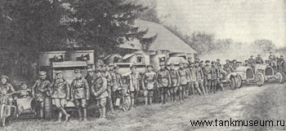
The Counter-Revolution
Civil War
Whites
vs. Reds
Royalists, moderates, liberal democrats
Communists

Slide 46
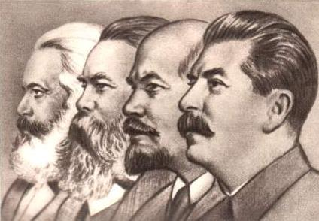
Union of Soviet Socialist Republics

Slide 47
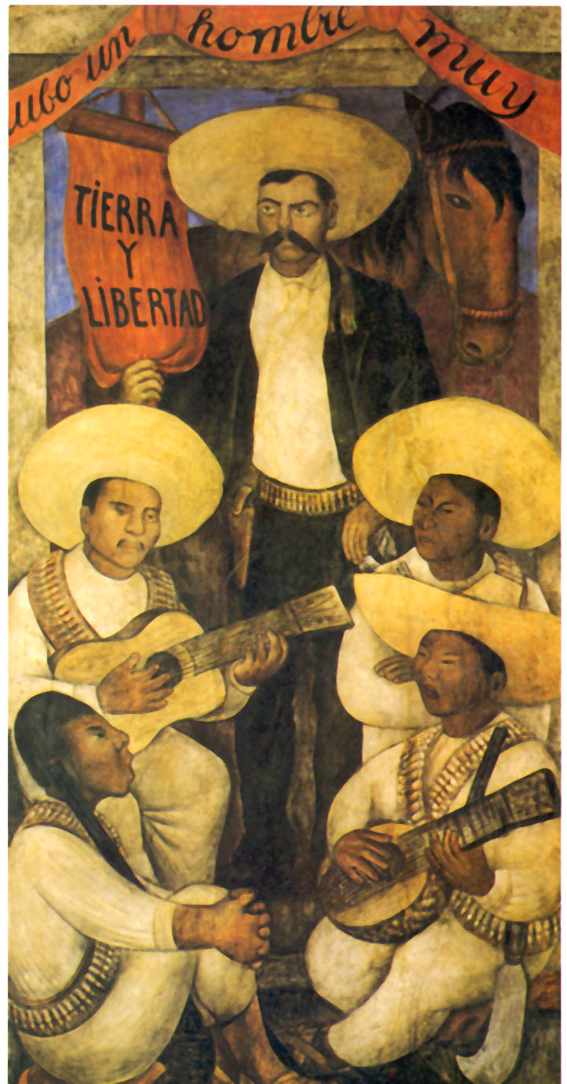
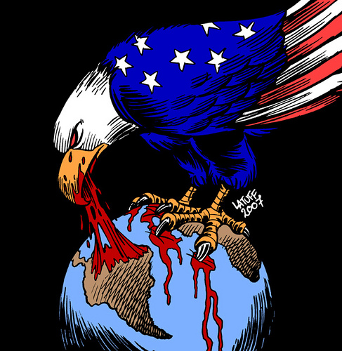
Mexican Revolution, 1910-1920
Legacy of Imperialism
Latin American politics controlled by landed elite, economy dominated by US and British firms
Mexican Revolution first violent effort to topple this system
Constitution of 1857 – failed attempt at land redistribution
Middle class joined with poor to fight government
Defeated in the end but forced government reform
Land Redistribution
Universal Suffrage
Public Education
Minimum Wage
Restrictions of foreign ownership of land and minerals

Slide 48
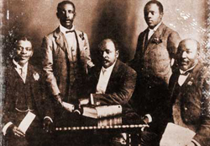
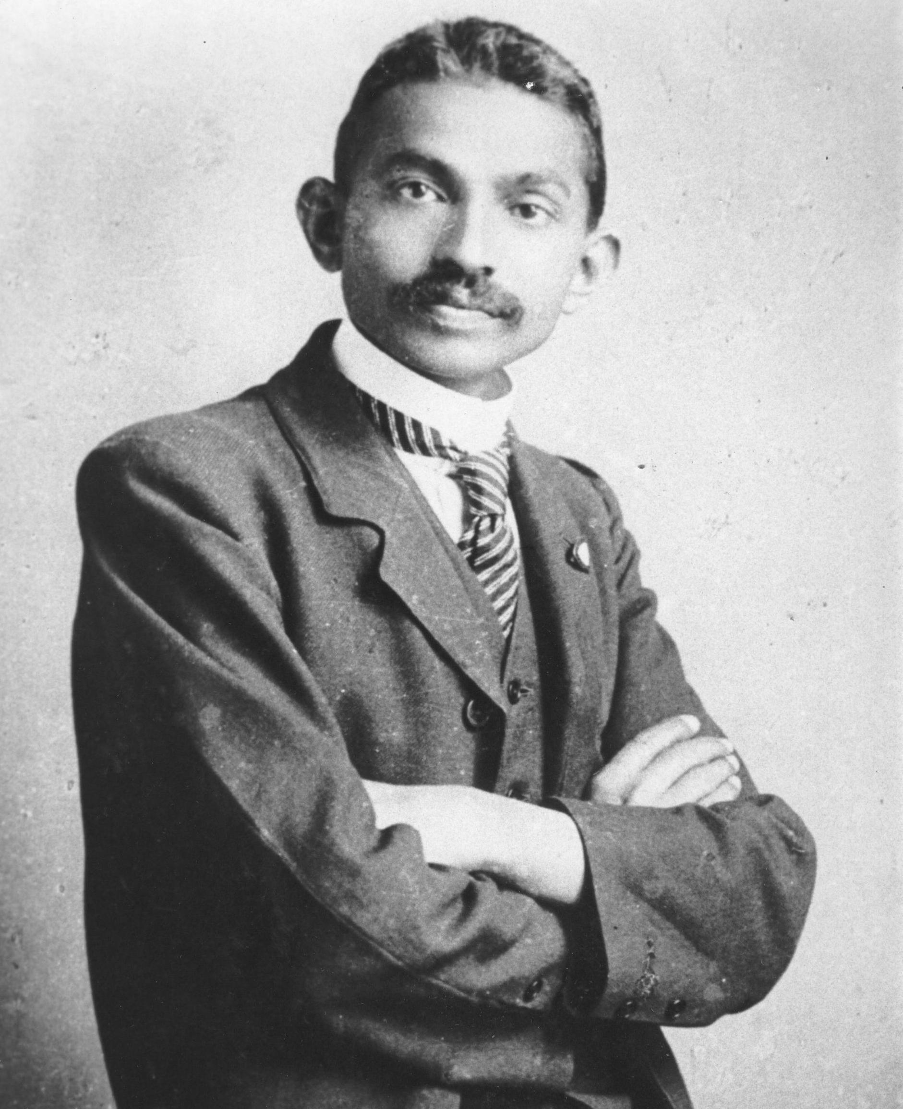
African National Congress created 1912
Gandhi returns to India, 1915
Legacy of Imperialism

Slide 49
Fall of Qing Dynasty founding of Chinese Republic, 1911
Legacy of Imperialism

Slide 51
China is ruled by the Qing Dynasty of Manchuria from 1644-1911
In 1911 China becomes a republic, the Emperor Henry Po Yee is confined to the Forbidden City and has no real power

Slide 52
What is going on out there?
This is Bull !

Slide 53
Balfour Declaration – first step in creation of Israel, 1917
This letter to Lord Rothschild, by the British Foreign Secretary Arthur James Balfour, was aimed at Jewish support for the Allies in the First World War. The letter, known as the "Balfour Declaration" became the basis movement to create a Jewish state in Palestine. The letter was published a week later in The Times (London) of London
Global Conflict
Foreign Office November 2nd, 1917 Dear Lord Rothschild: I have much pleasure in conveying to you. on behalf of His Majesty's Government, the following declaration of sympathy with Jewish Zionist aspirations which has been submitted to, and approved by, the Cabinet: His Majesty's Government view with favor the establishment in Palestine of a national home for the Jewish people, and will use their best endeavors to facilitate the achievement of this object, it being clearly understood that nothing shall be done which may prejudice the civil and religious rights of existing non-Jewish communities in Palestine, or the rights and political status enjoyed by Jews in any other country. I should be grateful if you would bring this declaration to the knowledge of the Zionist Federation. Yours, Arthur James Balfour

Slide 54
1920’s
Mussolini comes to power in Italy, 1922
Weimar Republic in Germany
Hitler becomes head of the Nazi Party, 1921
Russia becomes U.S.S.R., Stalin takes power
Stock Market Crash in U.S., 1929
Women gain the right to vote
German colonies turned over to British & French
Chinese Republic consolidates power
Republic of Turkey formed, 1923
Mandate Systems implemented
Non-Cooperation Movement in India, 1920
League of Nations meets, 1920

Slide 56
Notes:
Otto Dix 'Verwundeter (Herbst 1916, Bapaume) [Wounded soldier – Autumn 1916, Bapaume]' 1924 etching, aquatint, drypoint Collection of the National Gallery of Australia, The Poynton Bequest 2003 © Otto Dix, Licensed by VISCOPY

Slide 57
German colonies turned over to British & French
Republic of Turkey formed, 1923
Mandate Systems implemented
League of Nations meets, 1920
Legacy of WW I, Treaty of Versailles
Global Conflict
Global inter-connectedness

Slide 58
Mussolini comes to power in Italy, 1922
Weimar Republic in Germany
Hitler becomes head of the Nazi Party, 1921
Stock Market Crash in U.S., 1929
Rise of Fascism
Global Conflict
“A little something for everyone”

Slide 59
Brown Shirts

Slide 62
Hitler in Landsberg Prison

Slide 63
Mein Kampf: Hitler’s biography that established the platform of the Nazi Party, Declared Germans the master race and blamed Jews and Communist for German’s problems

Slide 64
Nazi Party Platform
Unification of Greater Germany (Austria + Germany)
Land + expansion
Anti-Versailles - abrogation of the Treaty.
Land and territory - lebensraum.
Only a "member of the race" can be a citizen.
Anti-semitism - No Jew can be a member of the race.
Anti-foreigner - only citizens can live in Germany.
No immigration - ref. to Jews fleeing pograms.
Everyone must work.
Abolition of unearned income - "no rent-slavery".
Nationalisation of industry
Divison of profits
Extension of old age welfare.
Land reform
Death to all criminals
German law, not Roman law (anti- French Rev.)
Education to teach "the German Way"
Education of gifted children
Protection of mother and child by outlawing child labour.
Encouraging gymnastics and swimming
Formation a national army.
Duty of the state to provide for its volk.
Duty of individuals to the state

Slide 66
Russia becomes U.S.S.R., Stalin takes power
Communism vs. Capitalism

Slide 67
Non-Cooperation Movement in India, 1920
Legacy of Imperialism

Slide 68
http://www.youtube.com/watch?v=0hgRLqBZuMQ

Slide 69
1930’s
Depression intensifies and spreads
Hitler takes power in Germany, 1933
Franco takes power in Spain, 1939
Soviet Five Year Plan
Great Depression deepens
Ethiopia falls to Italy, 1935
Chinese Civil War
Japanese invasion of China
British & French rule under Mandate System
Civil Disobedience in India

Slide 70
Notes:
Guernica is a painting by Pablo Picasso. It was created in response to the bombing of Guernica, Basque Country, by German and Italian warplanes at the behest of the Spanish Nationalist forces, on 26 April 1937, during the Spanish Civil War. The Spanish Republican government commissioned Picasso to create a large mural for the Spanish display at the Paris International Exposition at the 1937 World's Fair in Paris.

Slide 71
Notes:
Frozen Assets, Diego Rivera – Mexican Marxist painting of New York: In Frozen Assets, Rivera coupled his appreciation for New York’s distinctive vertical architecture with a potent critique of the city's economic inequities. The panel’s upper register features a dramatic sequence of largely recognizable skyscrapers, most completed within a few years of Rivera’s arrival in New York. In the middle section, a steel-and-glass shed serves as a shelter for rows of sleeping men, pointing to the dispossessed labor that made such extraordinary growth possible during a period of economic turmoil. Below, a bank’s waiting room accommodates a guard, a clerk, and a trio of figures eager to inspect their mounting assets in the vault beyond. Rivera’s jarring vision of the city—in which the masses trudge to work, the homeless are warehoused, and the wealthy squirrel away their money—struck a chord in 1932, in the midst of the Great Depression.

Slide 72
Chinese Civil War
Legacy of Imperialism
Civil War broke out in China in 1927 – the Republic vs. Communists

Slide 73
Depression intensifies and spreads
Hitler takes power in Germany, 1933
Franco takes power in Spain, 1939
Japanese invasion of China
Ethiopia falls to Italy, 1935
WW II Looms
Global Conflict
MAP

Slide 74
Soviet Five Year Plan
Communism vs. Capitalism

Slide 75
Civil Disobedience in India
Legacy of Imperialism

Slide 76
1940’s
World War II, 1939-1945
Cold War Begins, 1945
NATO formed, 1949
Atomic Bomb Developed
Fascists take power in Argentina & Brazil
South Africa Independent, Apartheid Established , 1948
China becomes Communist, 1948
Indonesia, Korea, & Philippines gain independence
Israel Established, 1948
Iraq & Jordan gain independence
India & Pakistan Independent, 1947
United Nations established, 1945

Slide 77
Socialist realism is a style of realistic art which was developed in the Soviet Union and became a dominant style in other communist countries. Socialist realism is a teleologically-oriented style having its purpose the furtherance of the goals of socialism and communism. Although related, it should not be confused with social realism, a type of art that realistically depicts subjects of social concern. Unlike social realism, socialist realism often glorifies the roles of the poor.
Notes:
Roses for Stalin. Stalin-era (1949). Painted by Boris Ieremeevich Vladimirski. Oil on canvas, 100.5 x 141 cm.

Slide 78
World War II, 1939-1945
Global Conflict

Slide 79
Total War leads to massive loss, example: Firebombing of Dresden
somewhere between 35,000 and 135,000--were dead.
A modern Russian Perspective, Russian Times.

Slide 80
Fascists take power in Argentina & Brazil
Legacy of Imperialism

Slide 81
Cold War Begins, 1945
NATO formed, 1949
Atomic Bomb Developed
Communism vs. Capitalism

Slide 84
China becomes Communist, 1948
Communism vs. Capitalism

Slide 85
South Africa Independent, Apartheid Established , 1948
Legacy of Imperialism

Slide 86
Israel Established, 1948
Global Conflict

Slide 87
India & Pakistan Independent, 1947
Legacy of Imperialism

Slide 88
United Nations established, 1945
Global inter-connectedness

Slide 89
1950’s
European Economic Community Established, 1957
Warsaw Pact, 1955
De-Stalinization of USSR
Sputnik, 1957
Cuba becomes Communist
H-Bomb
Nuclear Powered Submarines
Morocco, Tunis, Libya & Ghana gain independence
Korean War, 1950-53
Vietnam Fights for Independence
China’s Great Leap Forward, 1958-1961

Slide 91
Warsaw Pact, 1955
De-Stalinization of USSR
Sputnik, 1957
Cuba becomes Communist
H-Bomb
Nuclear Powered Submarines
Korean War, 1950-53
Communism vs. Capitalism

Slide 92
The Korean War, a UN Action?

Slide 93
China’s Great Leap Forward, 1958-1961
Communism vs. Capitalism

Slide 94
Great Leap Forward: 1958, Farms and industry organized into communes, Disastrous!

Slide 96
European Economic Community Established, 1957
Global inter-connectedness

Slide 97
Morocco, Tunis, Libya & Ghana gain independence
Legacy of Imperialism
Challenges
-cold war rivalries
Internal tribal conflict
White settlement
Took two basic paths:
Violent like Algeria
Diplomatic like Ghana

Slide 98
France was determined to hold on to Algeria
Large white population ( 2 million)
Officially part of France
Focus on Algeria allowed other French colonies of Africa to gain independence - led to a bloody war 1954-1962
bred nationalism in Africa = Negritude
http://www.youtube.com/watch?v=Ca3M2feqJk8

Slide 99
Ghana

Slide 100
1960’s
Berlin Wall Constructed
European Community Established, 1967
Khrushchev in power
Cuban Missile Crisis, 1962
Integration
Birth Control Pill, 1960
Silent Spring Published, 1962
Moon landing, 1969
Over 20 African Nations gain Independence
Vietnam War
Cultural Revolution in China, 1966
Malaysia and Singapore gain independence
PLO Formed, 1964
Six Day War, 1967
OPEC Established, 1960

Slide 101
Notes:
Artist Andy Warhol Year 1962 Type Synthetic polymer paint on canvas Dimensions Each 50.8 cm × 40.6 cm (20 in × 16 in) Location Museum of Modern Art. Acquired through the Lillie P. Bliss Bequest, New York, NY (32 canvas series displayed by year of introduction)

Slide 102
Berlin Wall Constructed
Khrushchev in power
Cuban Missile Crisis, 1962
Moon landing, 1969
Vietnam War
Communism vs. Capitalism

Slide 104
Cultural Revolution in China, 1966
Communism vs. Capitalism

Slide 105
European Community Established, 1967
Global inter-connectedness

Slide 106
Integration
Birth Control Pill, 1960
Silent Spring Published, 1962
Moon landing, 1969
Changing Reality

Slide 107
Over 20 African Nations gain Independence
Malaysia and Singapore gain independence
Legacy of Imperialism

Slide 108
PLO Formed, 1964
Six Day War, 1967
OPEC Established, 1960
Global Conflict

Slide 109
1970’s
Terrorism in the air and Olympics
Detente
Sandinistas take power, 1979
Greenpeace established, 1970
Most of Africa gain independence
Communism dominates in SE Asia
Arab-Israeli War, 1973
Oil Embargo, 1973
Revolution in Iran, 1979

Slide 110
Detente
Sandinistas take power, 1979
Communism dominates in SE Asia
Oil Embargo, 1973
Revolution in Iran, 1979
Communism vs. Capitalism

Slide 111
Iran
&
The Shah

Slide 113
US used CIA to try and overthrow an Islamic Fundamentalist government but it didn’t work – now they have a Islamic government that really doesn’t like us

Slide 114
Terrorism in the air and Olympics
Arab-Israeli War, 1973
Oil Embargo, 1973
Revolution in Iran, 1979
Global Conflict

Slide 115
Most of Africa gain independence
Side one
"So Much Trouble in the World" – 4:00
"Zimbabwe" – 3:49
"Top Rankin'" – 3:09
"Babylon System" – 4:21
"Survival" – 3:54
Side two
"Africa Unite" – 2:55
"One Drop" – 3:52
"Ride Natty Ride" – 3:53
"Ambush in The Night" – 3:14
"Wake Up And Live" – 4:58
Released 1979

Slide 116
1980’s
Fall of Berlin Wall, 1989
Perestroika and Glasnost in USSR
US supports contras in Nicaragua
AIDS outbreak
CNN Established
Personal Computer Introduced
Tiananmen Square Protests, 1989
Iran-Iraq War, 1980-1988

Slide 117
Notes:
Keith Haring

Slide 118
Fall of Berlin Wall, 1989
Perestroika and Glasnost in USSR
US supports contras in Nicaragua
Communism vs. Capitalism

Slide 119
Tiananmen Square Protests, 1989
Communism vs. Capitalism

Slide 120
CNN Established
Personal Computer Introduced
Global inter-connectedness

Slide 121
AIDS outbreak
Changing Reality

Slide 122
1990’s
European Union formed, 1993
Unification of Germany, 1990
Communism dismantled in Eastern Europe
Euro introduced, 1999
Collapse of the Soviet Union, 1991
NAFTA established, 1993
Internet becomes available
Apartheid ends, 1990
Genocide in Rwanda, 1994
Hong Kong returned to China, 1997
China moves to a market economy
Gulf War, 1991
Taliban take power in Afghanistan, 1996
India & Pakistan become Nuclear Powers

Slide 123
Unification of Germany, 1990
Communism dismantled in Eastern Europe
Collapse of the Soviet Union, 1991
China moves to a market economy
Communism vs. Capitalism

Slide 124
Click here

Slide 125
European Union formed, 1993
Euro introduced, 1999
NAFTA established, 1993
Internet becomes available
Global inter-connectedness

Slide 126
Apartheid ends, 1990
Genocide in Rwanda, 1994
Legacy of Imperialism

Slide 127
Taliban take power in Afghanistan, 1996
Communism vs. Capitalism
Global Conflict

Slide 128
India & Pakistan become Nuclear Powers
Legacy of Imperialism

Slide 129
http://www.youtube.com/watch?v=0SrUkZFSc5M

Slide 130
2000’s
Global Conflict
September 11th Attacks, 2001
FaceBook Launched, 2003
YouTube Launched, 2005
Global Economic Recession begins, 2008
U.S. invasion of Iraq, 2002
U.S. invasion of Afghanistan, 2001
Changing Reality
Global Conflict

Slide 131
Notes:
The African Renaissance Monument to mark Senegal's 50 years of independence is pictured during its inauguration ceremony on April 3, 2010 in Dakar. Former Nigerian president Olusegun Obasanjo, who cut a ribbon in the colours of the Senegalese flag, said the statue was 'a monument for black people all over the world.' Senegal's President Abdoulaye Wade called for the creation of a United States of Africa, unveiling the statue which he said marked the moment for the continent to 'take-off'.
The controversial bronze work -- which at 50 meters (164 feet) stands four meters taller than the Statue of Liberty -- depicts a couple rising from the mouth of a volcano. To finance the project, the state has been selling off government land to the private sector, a policy that has itself been criticized. Photo by Seyllou/ AFP/ Getty Images

Slide 132
2010’s
Greek Debt Crisis shakes Eurozone
South Sudan gain’s independence
Legacy of Imperialism

